Slide 1

Sentimental Analysis of domestic Car by Text Mining
김 동 화, 김 형 석, 류 나 현

Slide 2
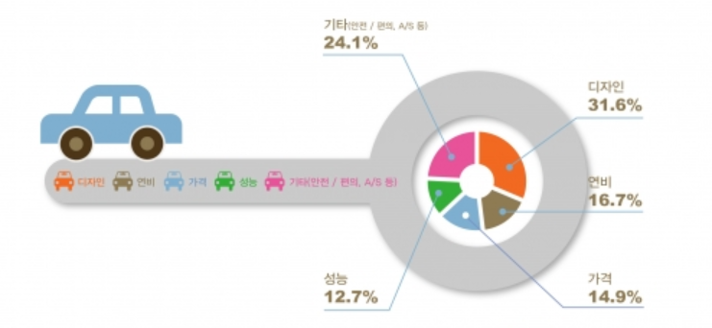
Analysis Plan
Which car model is better than others ?
What is the key factor to be determined for purchase?
= Answer to the question comes into sentiment analysis

Slide 3
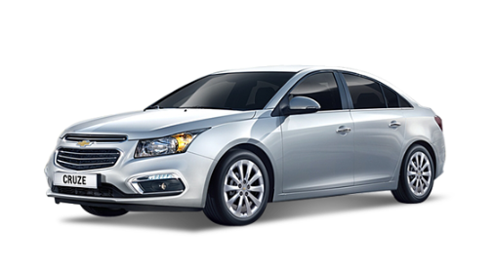
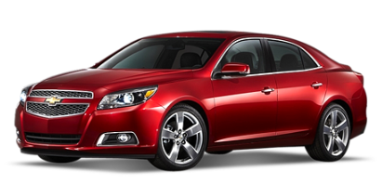
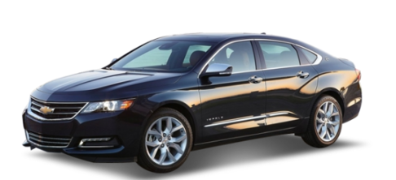
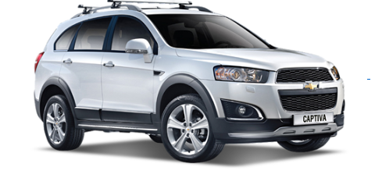

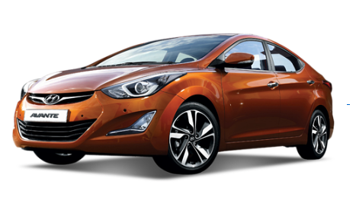
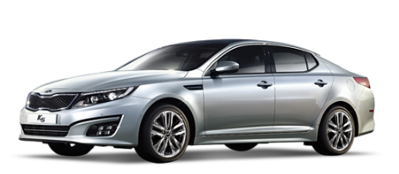
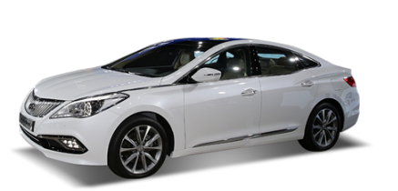
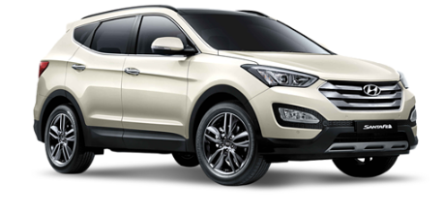

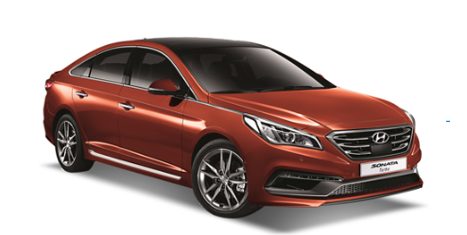
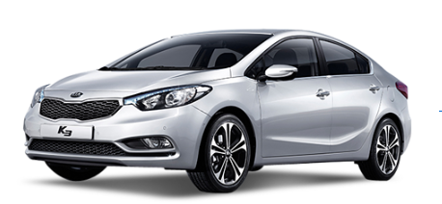
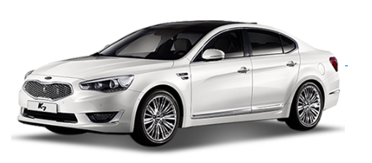
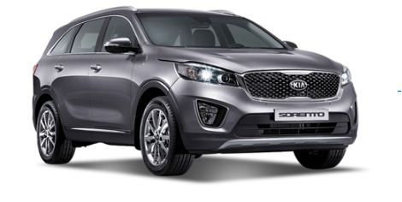

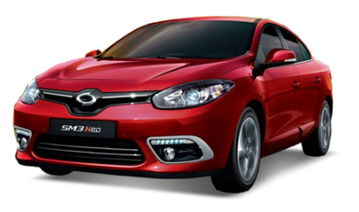
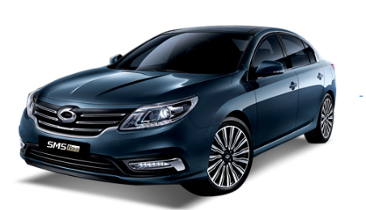
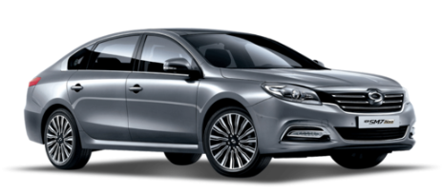
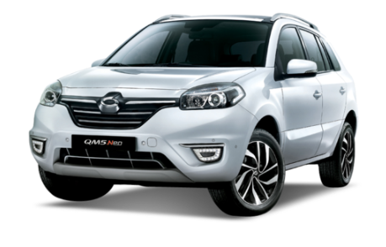

Application of Sentiment Analysis
Large size car
Compact car
Midsize car
Sport utility vehicle
2015 크루즈
2015 말리부
2014 임팔라
2015 캡티바
2015 아반떼
2015 K5
2015 그랜저
2015 싼타페
2015 K3
2015 쏘나타
2015 K7
2015 쏘렌토
2015 SM3
2015 SM5 노바
2014 SM7 노바
2015 QM5

Slide 4
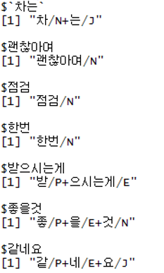
Pos tagging
품사 분류
Sentence
“차는 괜찮아여 점검 한번 받으시는게 좋을것 같네요”

Slide 5

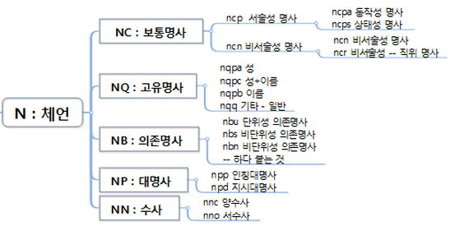
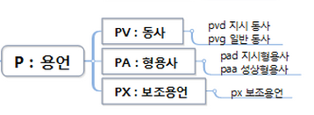
Pos tagging
SimplePos09 is better for interpreting than SimplePos22

Slide 6
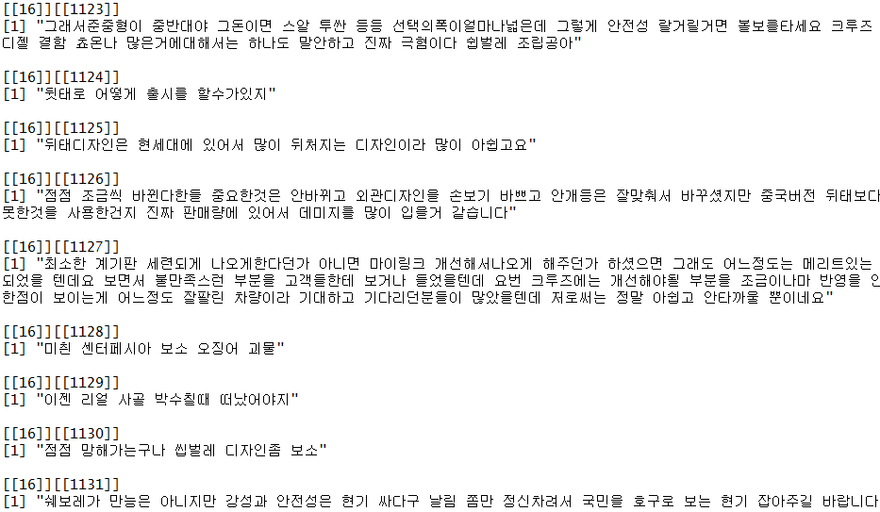
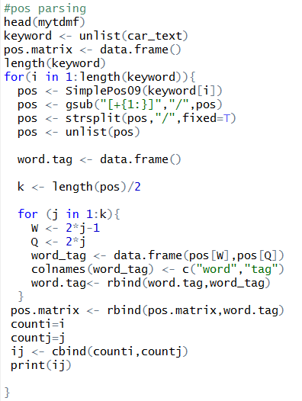
Pos tagging

Slide 7
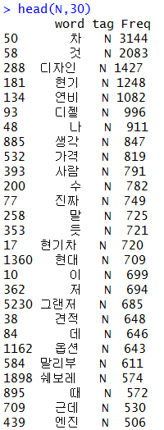
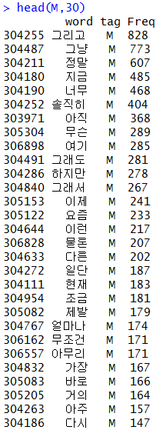
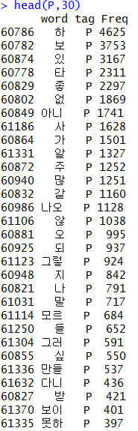
Pos tagging
noun | adverb | Verb & adjective

Slide 8


Pos tagging
1. What are the factors for purchasing a car?
2. What is the polarity for keywords and factor score?
3. In detail, What is the predicate of the factors for purchasing a car?

Slide 9
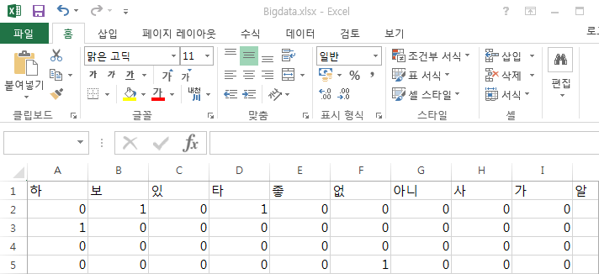
Keyword Network
명사 and 동사 Pos Variable
Sentence 1
Matrix
Sentence 2
Sentence 3
.
.
.
.
.
.
Sentence n

Slide 10
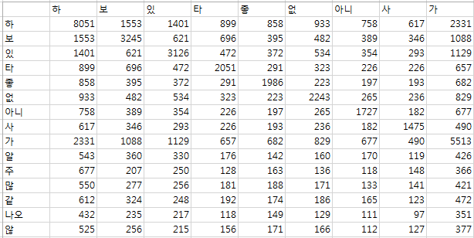
Keyword Network
.
.
.
.
.
.
Sentence 1
Sentence 2
Sentence 3
Sentence n
명사 and 동사 Pos Variable
Sentence 1
Matrix
명사 and 동사 Pos Variable
Sentence 2
Sentence 3
Matrix
.
.
.
.
.
.
Sentence n

Slide 11
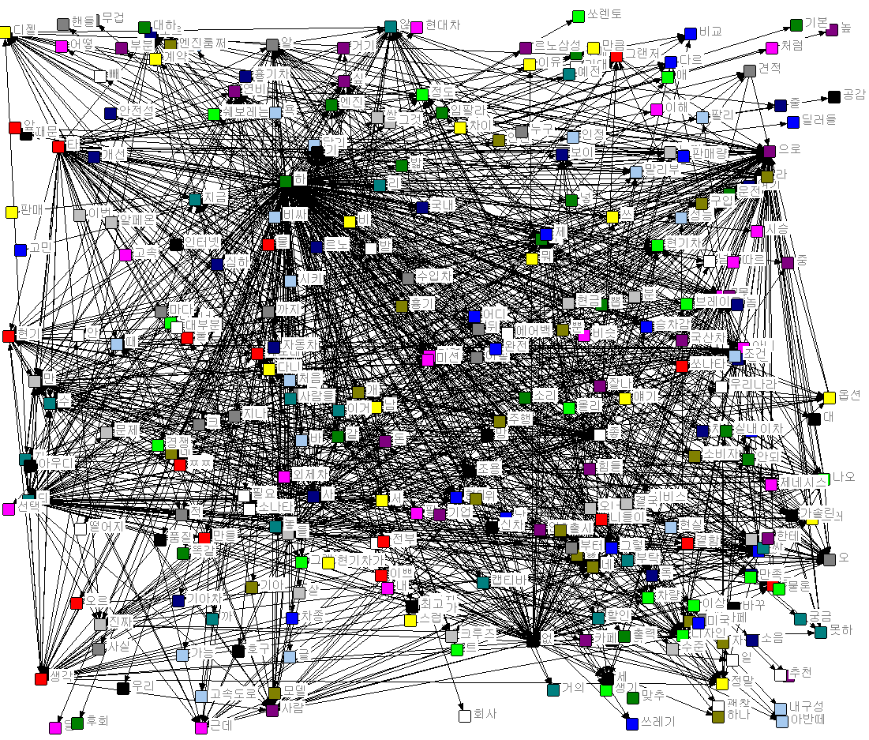
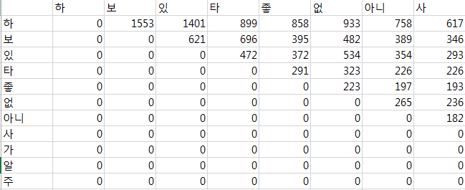
Keyword Network
Frequency 50~1000

Slide 12
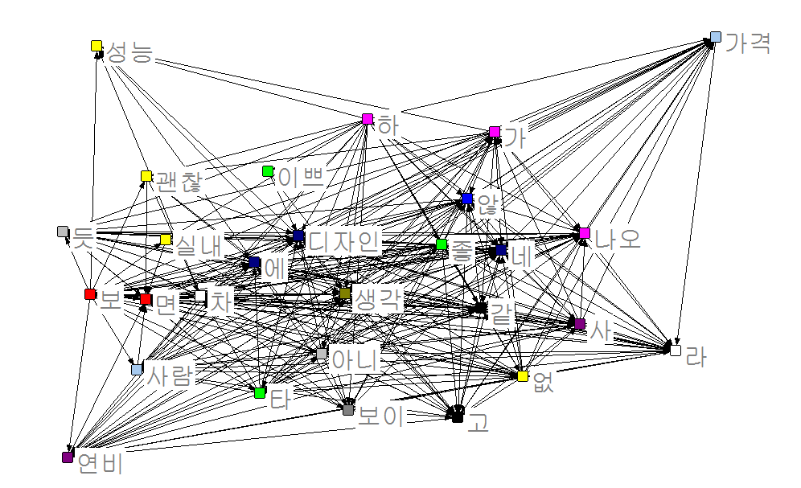
Keyword Network
Egonet for 디자인

Slide 13
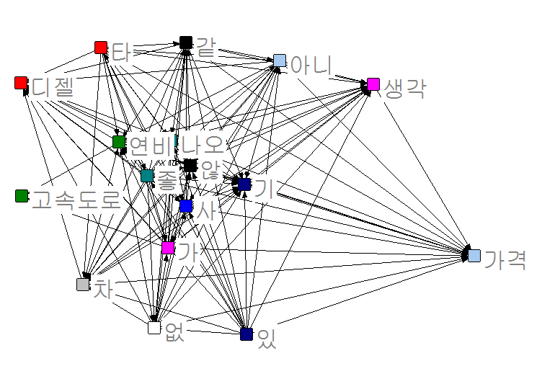
Keyword Network
Egonet for 연비

Slide 14
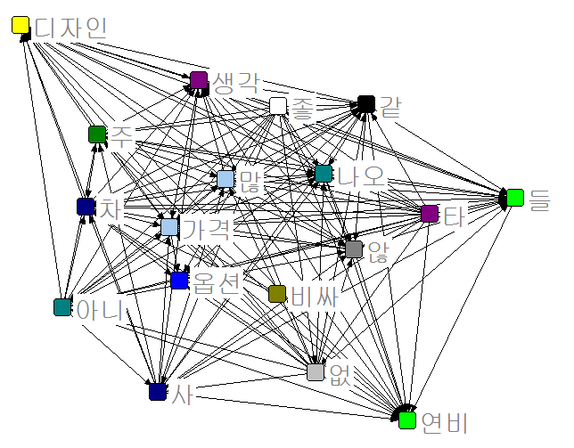
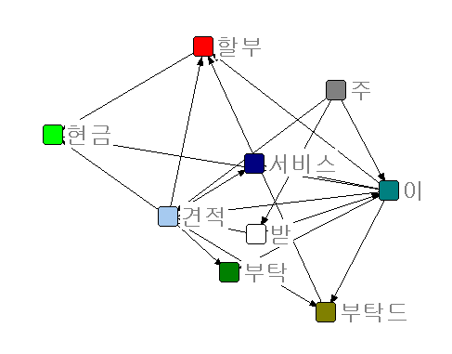
Keyword Network
Egonet for 가격, 견적

Slide 15
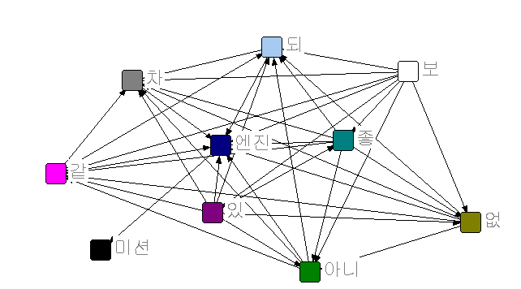
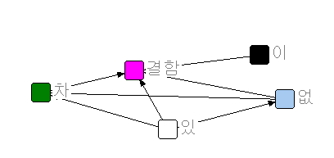
Keyword Network
Egonet for 결함, 엔진

Slide 16
Purchase determinants
Emotional
디자인, 만족, 서비스, 승차감, 시승, 신차, 스타일, 페이스리프트,외관,색상,감성
Performance
기능, 디젤, 옵션, 엔진, 가솔린, 성능, 고속, 엔진룸, 풀옵, 터보,기술력
Economic
가성비, 연비, 가격, 견적, 구매, 돈, 할인, 차값, 경제
Faulty
문제, 결함, 안전, 소음, 단점, 진동, 정숙성, 잔고장, 물샘

Slide 17
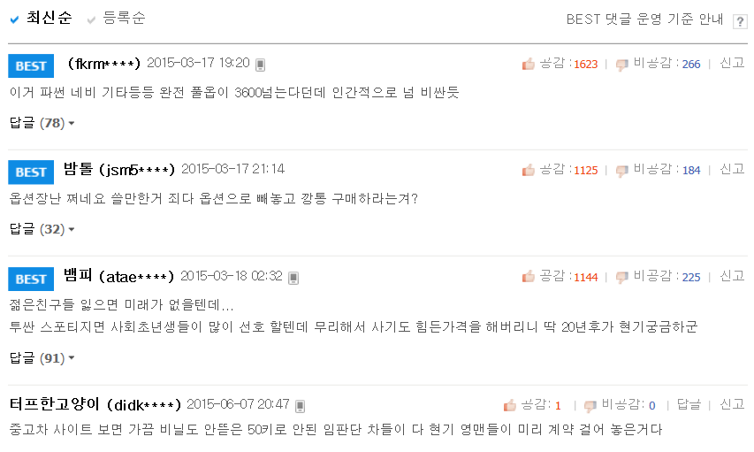
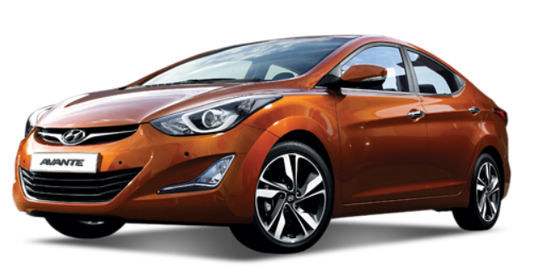
Sentiment Analyze
Car_score
Sum(sentence_polarity)

Slide 18
Sentiment Analyze
디자인 괜찮은거같은데
디자인 완전극혐 디자인충들 씹극혐
앞모습은 예전이랑 비슷한거 같고 뒷 디자인이 많이 개선 된거 같은데
Positive
+1
Negative
-1
-1
Neutrality
-1
+1

Slide 19
Sentiment Analyze
Emotional
Performance
Economic
Faulty
Sum(sentence_polarity)
Sum(sentence_polarity)
Sum(sentence_polarity)
Sum(sentence_polarity)
Emotional
score
Performance
score
Economic
score
Faulty
score

Slide 20
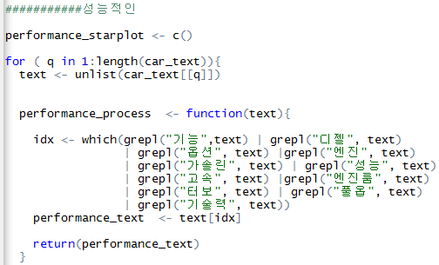
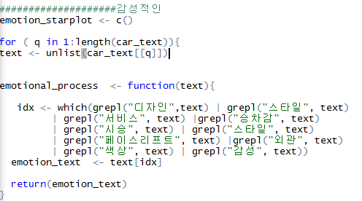
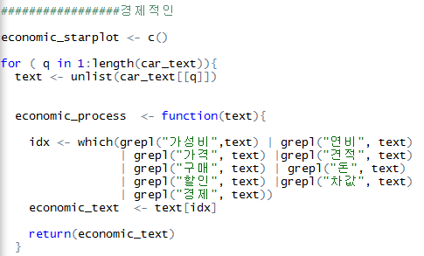
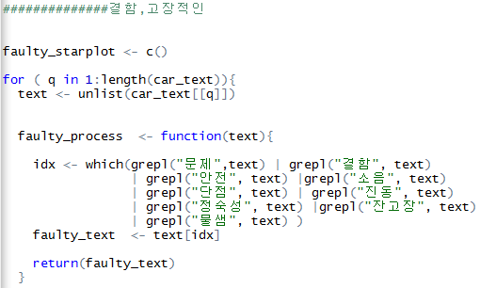
Sentiment Analyze

Slide 21
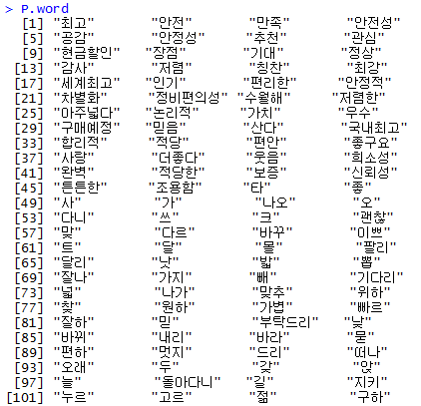
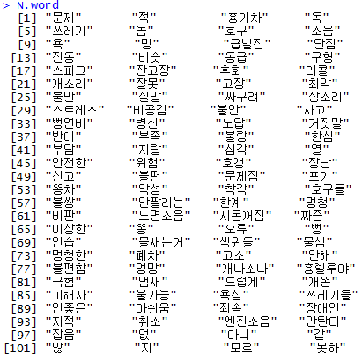
Sentiment Analyze
Positive word
Negative word

Slide 22
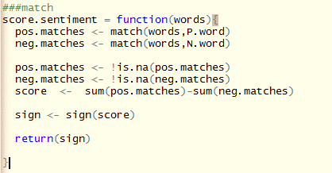
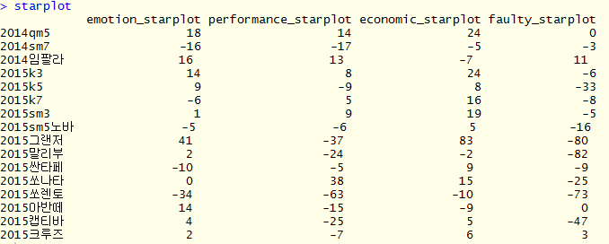
Sentiment Analyze

Slide 23
Sentiment Analyze

Slide 24
Sentiment Analyze

Slide 25
Sentiment Analyze

Slide 26
Opinion Predicate Enrichment
Opinion predicate can provide meaningful information.
스타일– 디자인이 예쁘다
기능성 – 진동이 작다
경제성 – 연비가 좋다
내구성– 안정성이 떨어지다, 잔 고장이 없다
Method to enrich predicate based pattern

Slide 27
Opinion Predicate Enrichment
At least should be one verb in pos_pattern.
#ngram | pos_pattern | morpho_pattern
2gram | NV | 디자인 예쁘
2gram | VV | 알 보
2gram | NV | 디자인 예쁘
2gram | NV | 디자인 예쁘
3gram | NNV | 차 사려 하
3gram | VNV | 구하 선택 하
3gram | NNV | 팔생각에 중고감가 따지
3gram | NNV | 차 스마트폰 바꾸
4gram | NNVV | 제동성 내구성 타 갈
4gram | VNNV | 따지 차 스마트폰 바꾸

Slide 28



Opinion Predicate Enrichment
$Predicate$ = $\operatorname{argmax}{ P\left(단어패턴\right) × P(품\text{사패턴}\text{)}}$
$$단어패턴$$

Slide 29
Opinion Predicate Enrichment
#ngram | pos_pattern | morpho_pattern | P(pos_pattern) | P(morpho_pattern)
2gram | NV | 디자인 예쁘 | 4/5 | 3/5
2gram | VV | 알 보 | 1/5 | 1/5
2gram | NV | 디자인 예쁘 | 4/5 | 3/5
2gram | NV | 디자인 예쁘 | 4/5 | 3/5
2gram | NV | 차 사 | 4/5 | 1/5
3gram | VNV | 구하 선택 하 | 1/3 | 1/3
3gram | NNV | 팔생각에 중고감가 따지 | 2/3 | 1/3
3gram | NNV | 차 스마트폰 바꾸 | 2/3 | 1/3
4gram | NNVV | 제동성 내구성 타 갈 | 1/2 | 1/2
4gram | VNNV | 따지 차 스마트폰 바꾸 | 1/2 | 1/2

Slide 30
Opinion Predicate Enrichment
Emotional
Performance
Economic
Faulty
Sum(sentence_polarity)
Sum(sentence_polarity)
Sum(sentence_polarity)
Sum(sentence_polarity)
Emotional
score
Performance
score
Economic
score
Faulty
score
Opinion Predicate
Opinion Predicate
Opinion Predicate
Opinion Predicate

Slide 31
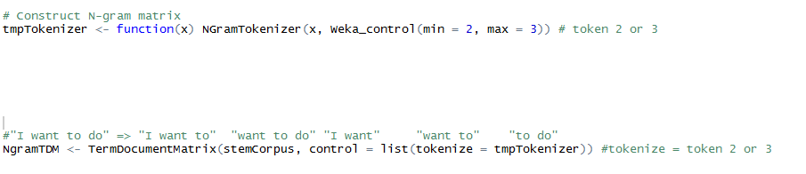
Opinion Predicate Enrichment
NGramTokenizer_function is based on word spacing.

Slide 32

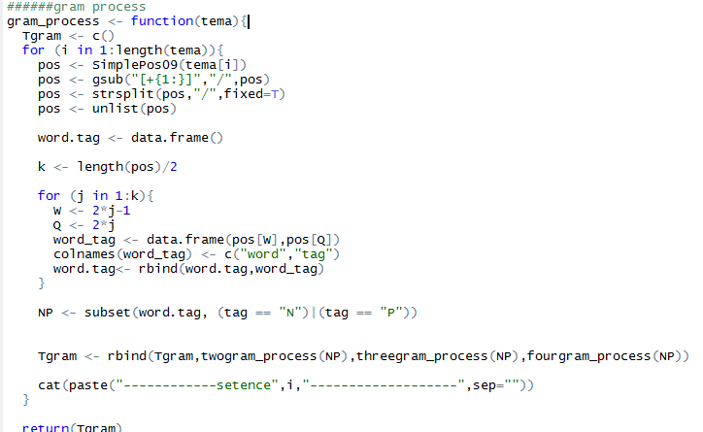
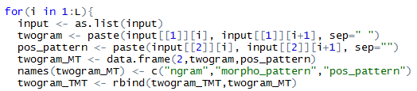

Opinion Predicate Enrichment
Gram_Function is based on Simplepos09.
2gram
3gram

Slide 33
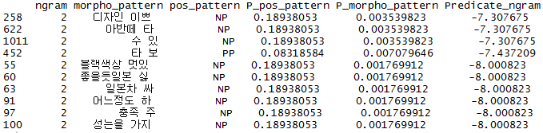
Opinion Predicate Enrichment
Emotional predicate for 아반떼
Log(P)

Slide 34
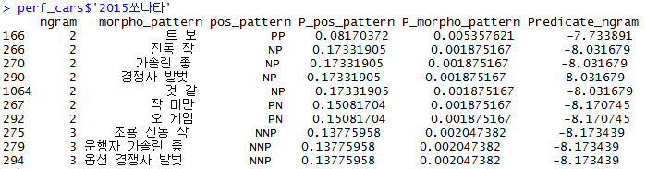
Opinion Predicate Enrichment

Slide 35

Opinion Predicate Enrichment

Slide 36

Opinion Predicate Enrichment

Slide 37
Q & A

